Slide 1
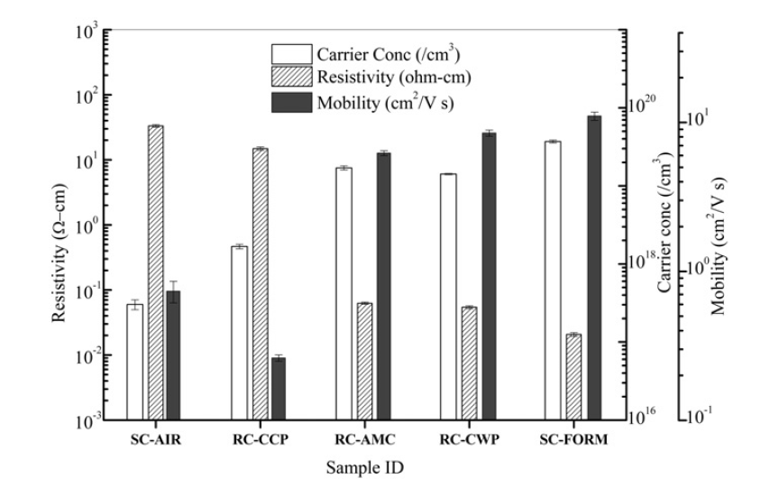
Data Summary and presentation

Slide 2
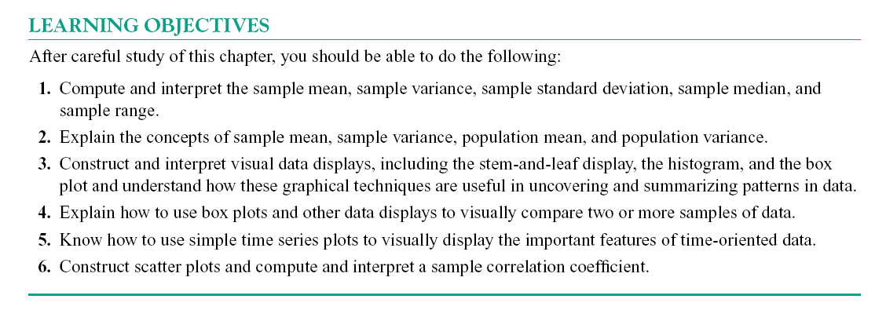

Slide 3
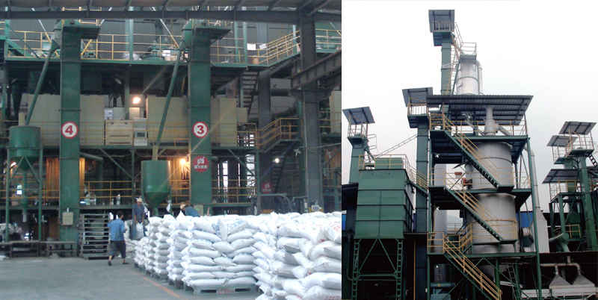
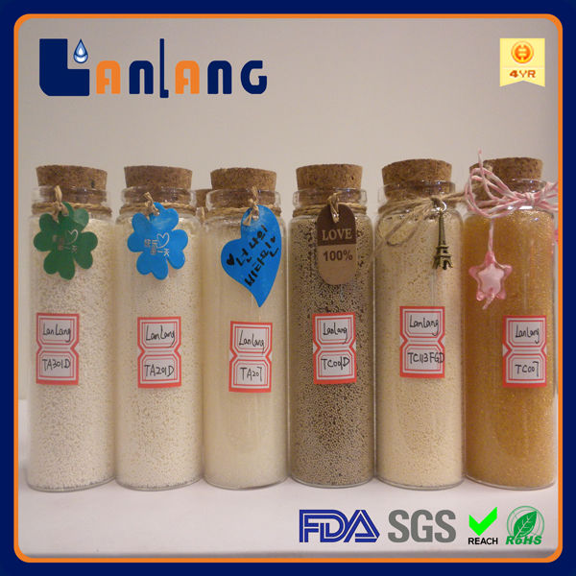
Population and sample

Slide 4
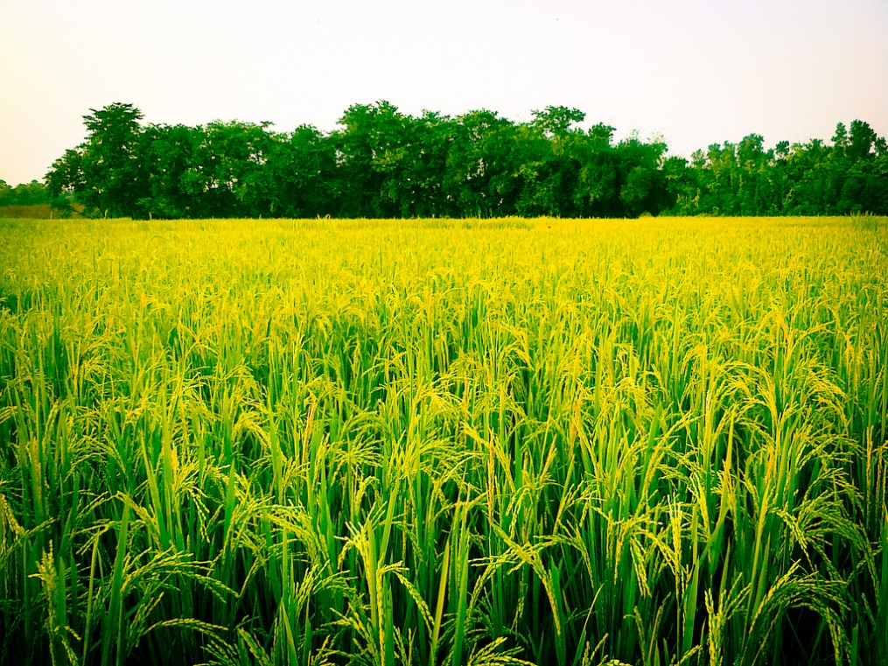
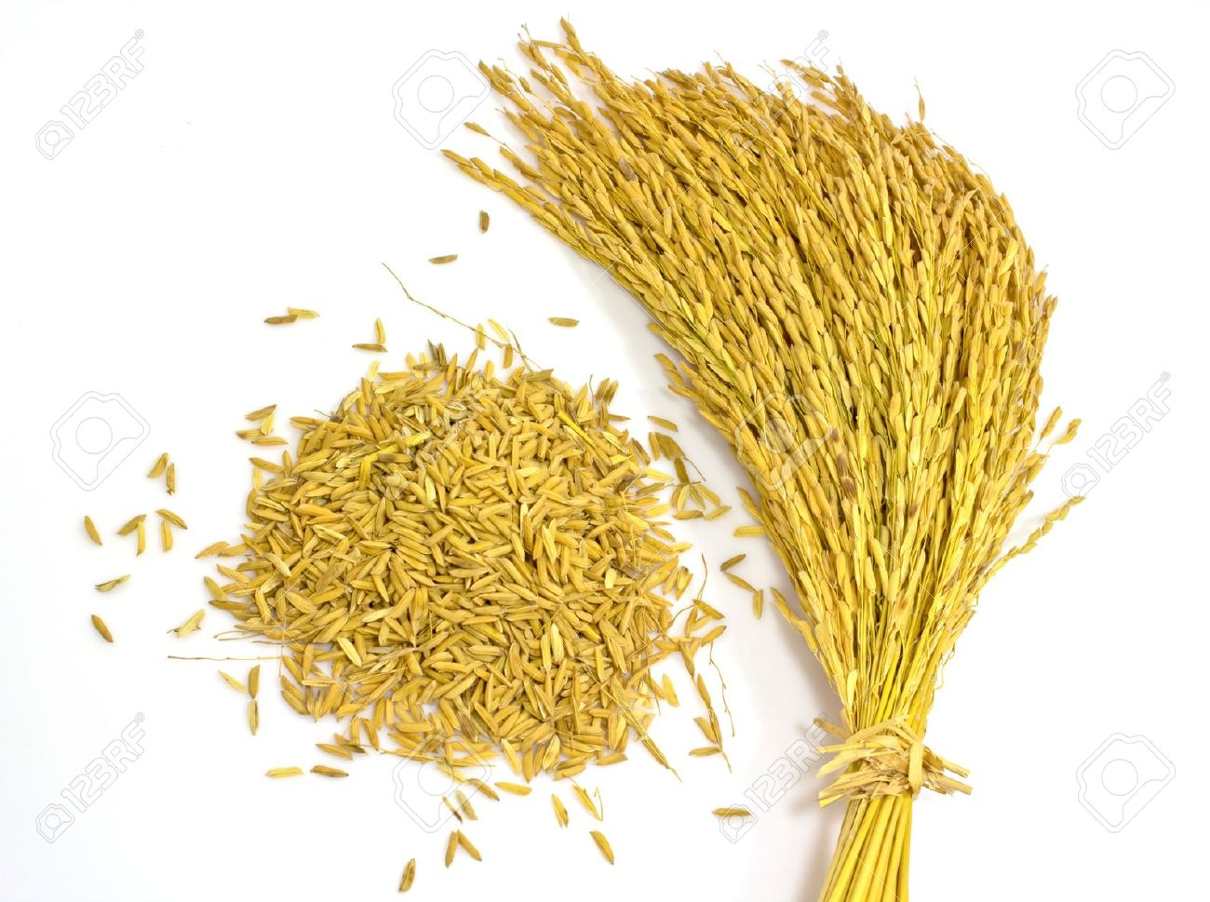
Population and sample

Slide 5
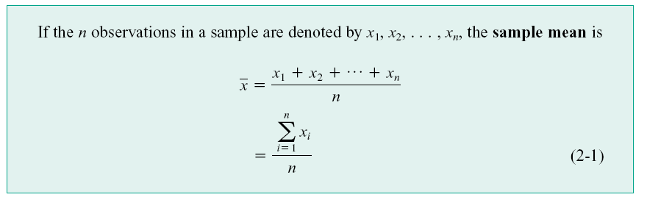
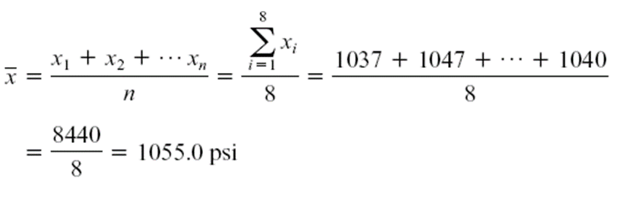

Sample Mean
Data: Tensile strength (psi) of randomly selected 8 O-Rings:
1037, 1047, 1066, 1048, 1059, 1073, 1070, 1040

Slide 6
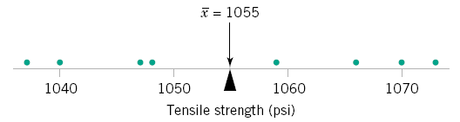
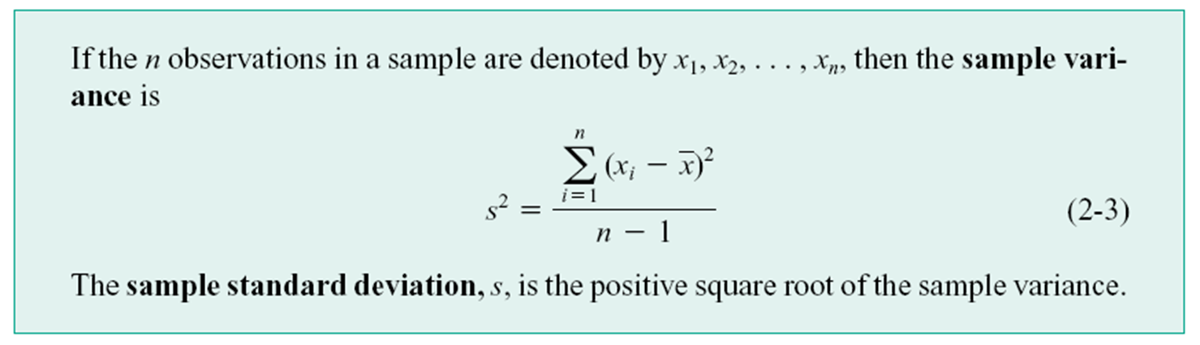
How much is the variability?
A visual qualitative representation (Dot Diagram) is often useful.
Quantitative measure of variability: Sample Variance and Sample Standard Deviation

Slide 7
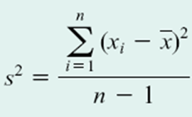
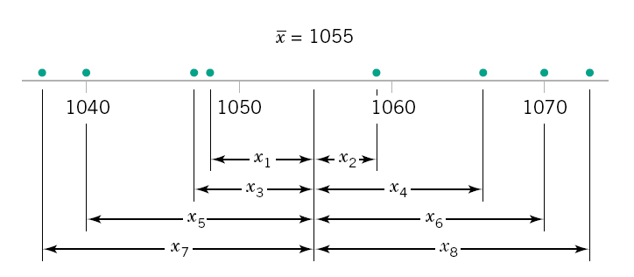
Why s² is a measure of variability?
Why n-1 and not n?

Slide 8
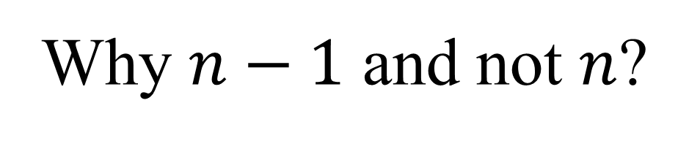
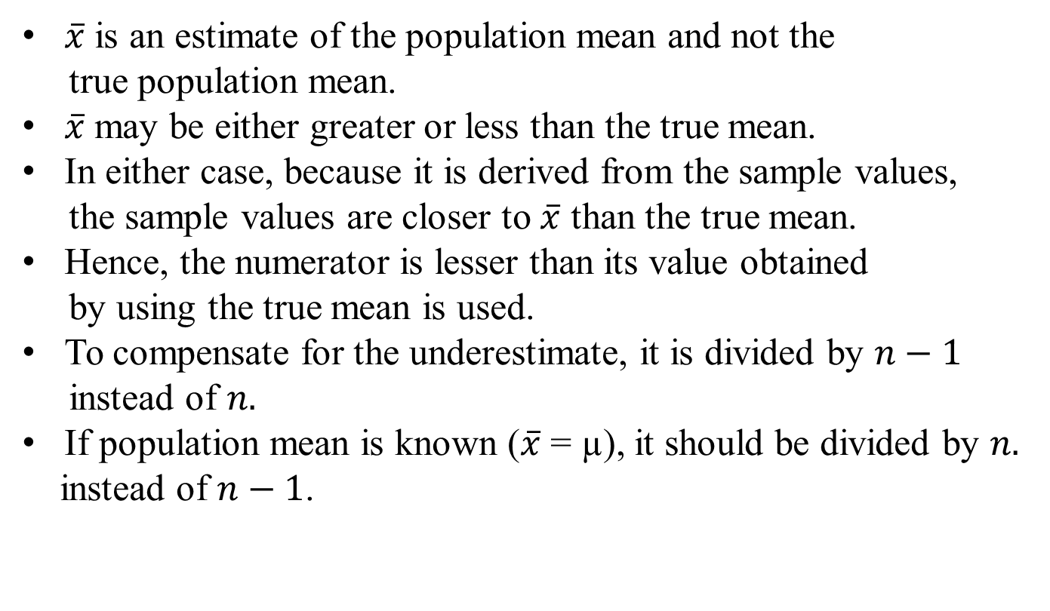

Slide 9
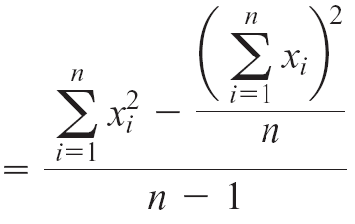
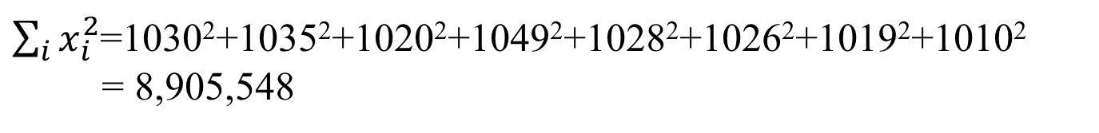


Calculation of sample variance
Substituting:
and
Large data sets: stem and leaf diagram

Slide 10
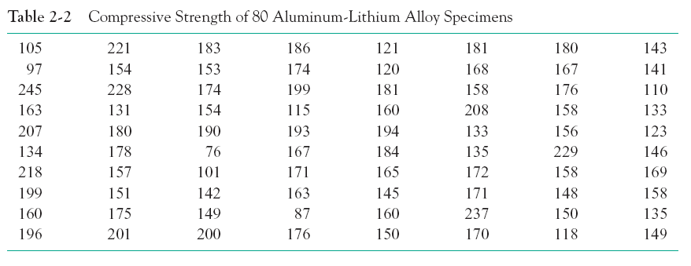
Compressive strength data

Slide 11
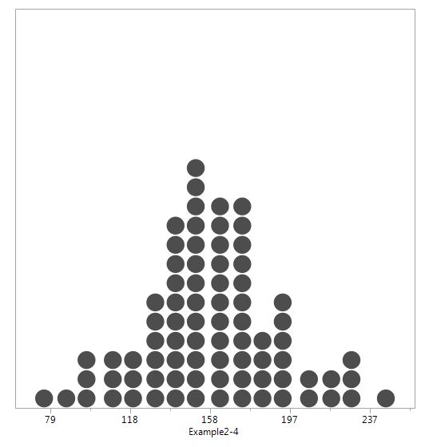
Dot diagram for large dataset

Slide 12
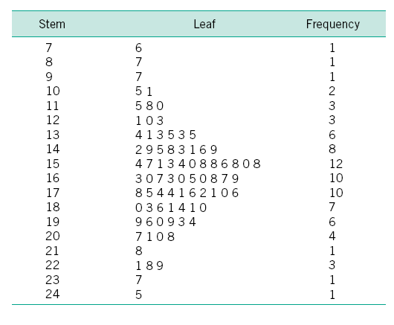
Stem-and-Leaf Diagram

Slide 13
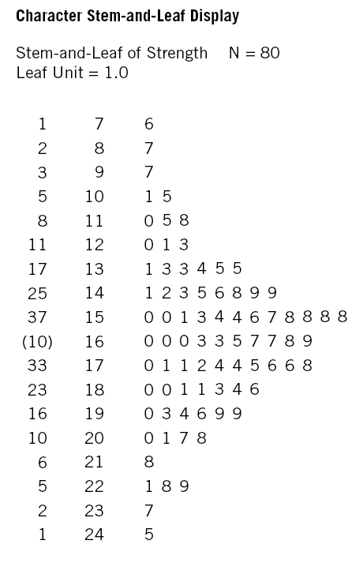
Ordered Stem-and-Leaf Diagram

Slide 14

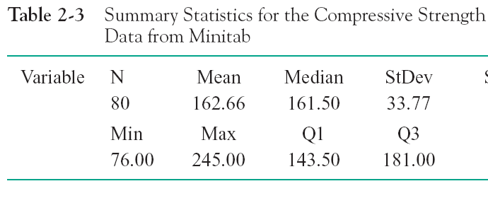
Interpretation
Median: 161.5
Range: 169
First quartile (Q1) : 143
Third quartile (Q3) : 181
IQR: 181-143=38

Slide 15
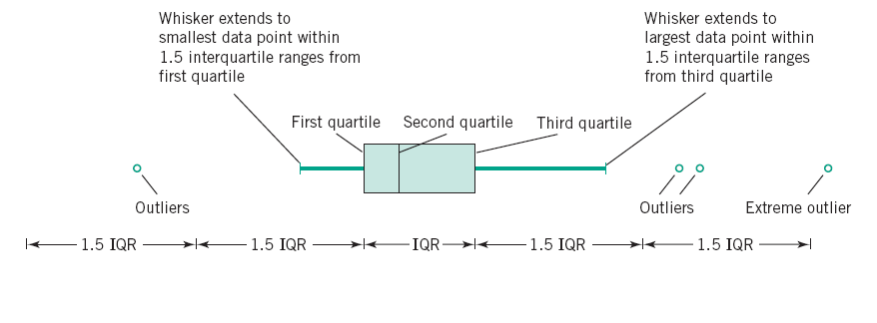
Box Plots
The box plot is a graphical display that simultaneously describes several important features of a data set, such as center, spread, departure from symmetry, and identification of observations that lie unusually far from the bulk of the data.
Data axis (e.g. tensile strength)

Slide 16
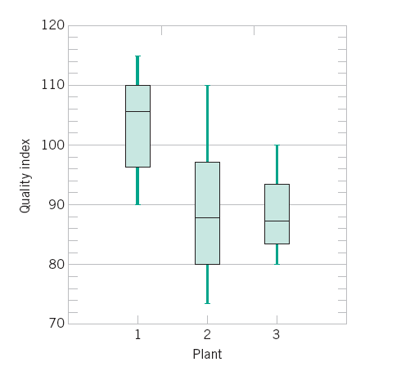
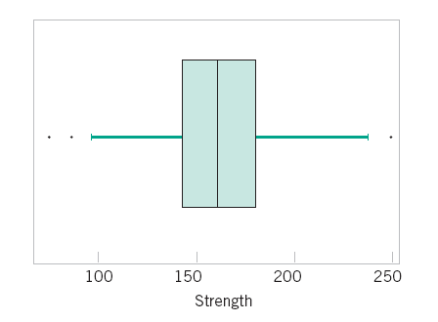
Box Plot examples
Median: 161.5
Range: 169
First quartile (Q1) : 143
Third quartile (Q3) : 181
IQR: 181-143=38
1.5 IQR=57

Slide 17
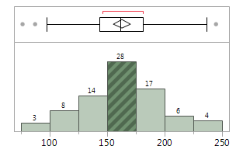
Histograms
A histogram is a more compact summary of data than a stem-and-leaf diagram. To construct a histogram for continuous data, we must divide the range of the data into intervals, which are usually called class intervals, cells, or bins. If possible, the bins should be of equal width to enhance the visual information in the histogram.

Slide 18
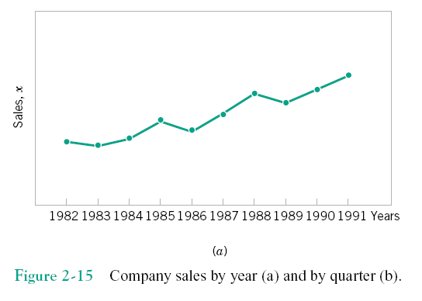
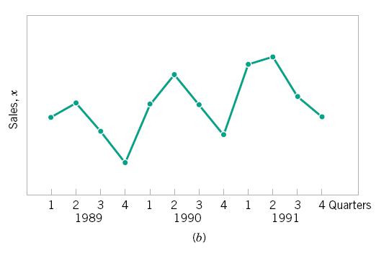
Time Series Plots
A time series or time sequence is a data set in which the observations are recorded in the order in which they occur.
trends,
cycles, or
other broad features of the data

Slide 19
Multivariate Data
The dot diagram, stem-and-leaf diagram, histogram, and box plot are descriptive displays for univariate data; that is, they convey descriptive information about a single variable.
Many engineering problems involve collecting and analyzing multivariate data, or data on several different variables.
In engineering studies involving multivariate data, often the objective is to determine the relationships among the variables or to build an empirical model.

Slide 20
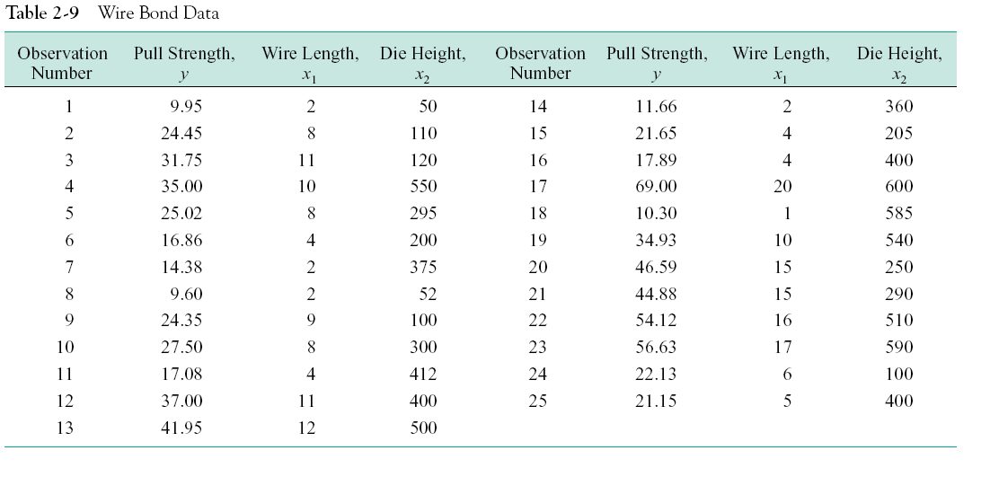
Multivariate Data: Example

Slide 21
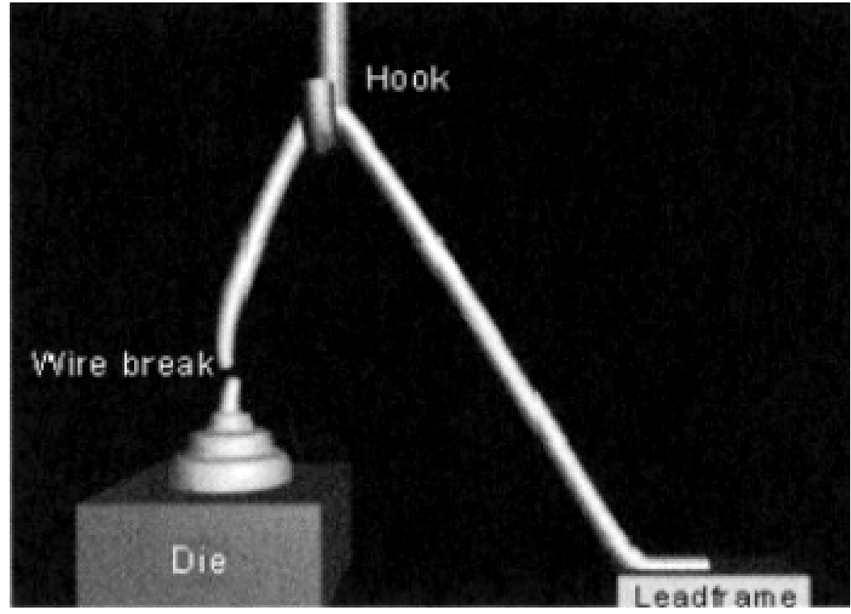
Wire bond pull strength
Wang and Sun; Modern applied science: Vol 3; No 12

Slide 22
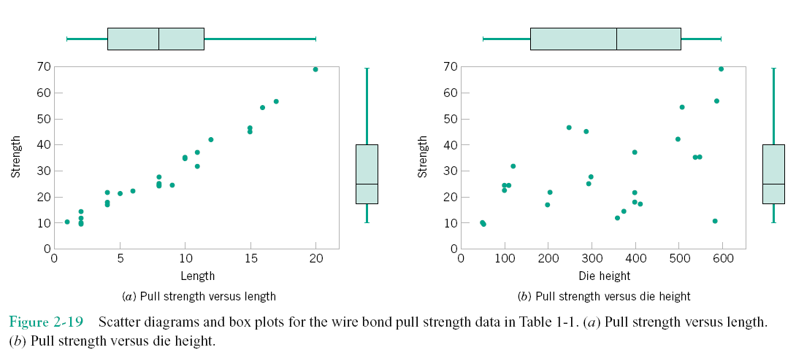
Scatter plots: Pairwise visualization

Slide 23
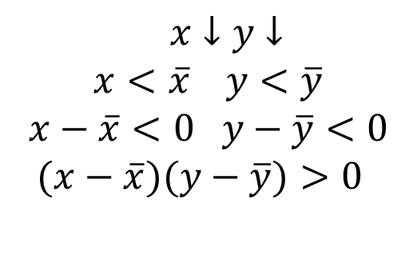
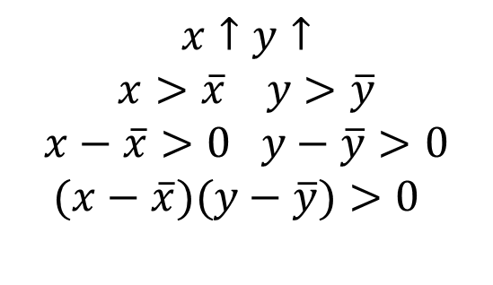
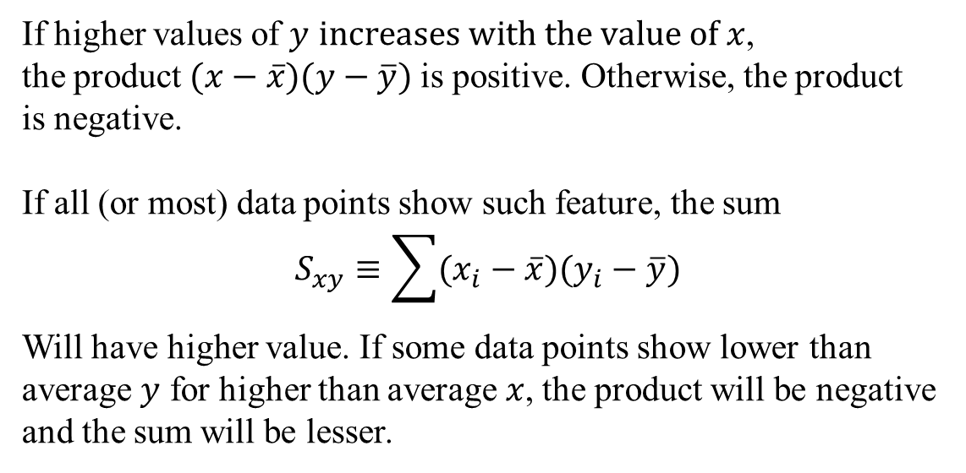
Correlation coefficient
$$x↑y↑$$
$$x>\overline{x} y>\overline{y}$$
$$x−\overline{x}>0 y−\overline{y}>0$$
$$(x−\overline{x})(y−\overline{y})>0$$
$x↓y$ $↓$
$$x<\overline{x} y<\overline{y}$$
$$x−\overline{x}<0 y−\overline{y}<0$$
$$(x−\overline{x})(y−\overline{y})>0$$
If higher values of $y$ $increases with the value of x$,
the product$(x−\overline{x})(y−\overline{y})$ is positive. Otherwise, the product
is negative.
If all (or most) data points show such feature, the sum
$$S_{xy}≡\sum{(x_{i}−\overline{x})(y_{i}−\overline{y})}$$
Will have higher value. If some data points show lower than
average $y$ for higher than average $x$, the product will be negative
and the sum will be lesser.

Slide 24
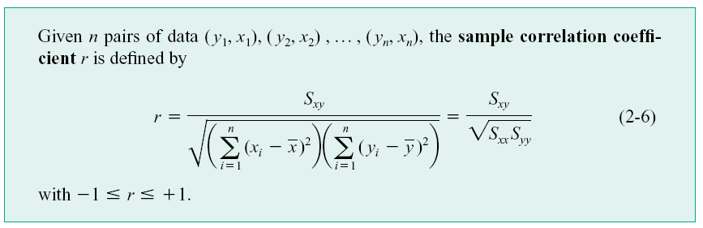
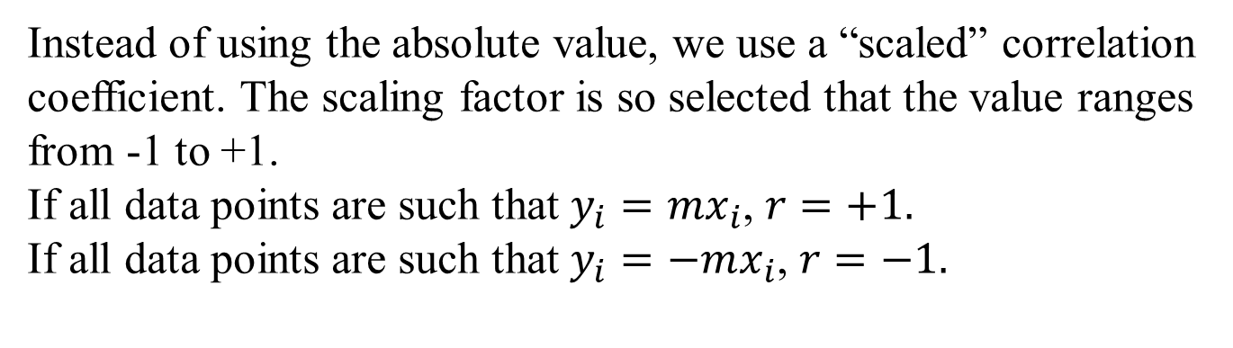
Correlation coefficient
Instead of using the absolute value, we use a “scaled” correlation
coefficient. The scaling factor is so selected that the value ranges
from -1 to +1.
If all data points are such that $y_{i}=mx_{i}$, $r=+1.$
If all data points are such that $y_{i}=−mx_{i}$, $r=−1.$

Slide 25


Scatter plots: Pairwise visualization
$$r=0.982$$
$$r=0.493$$

Slide 26
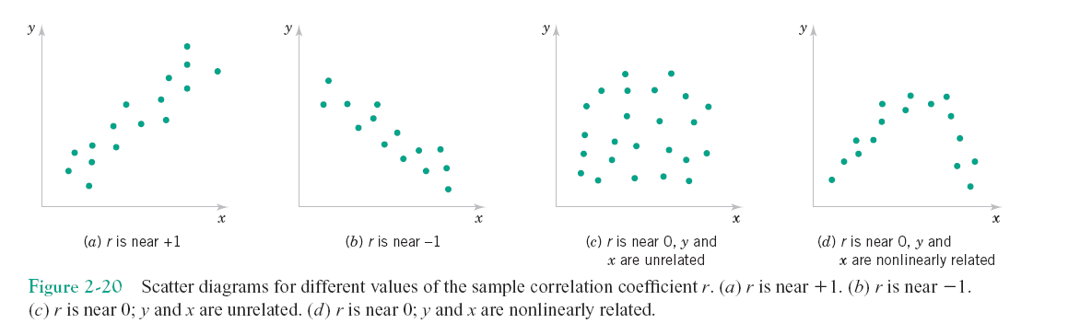
Features of multivariate Data

Slide 27
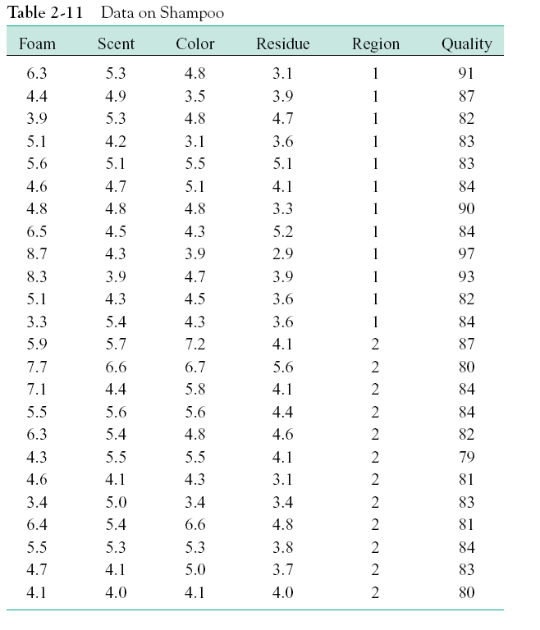
Multivariate Data: Multiple pairs

Slide 28
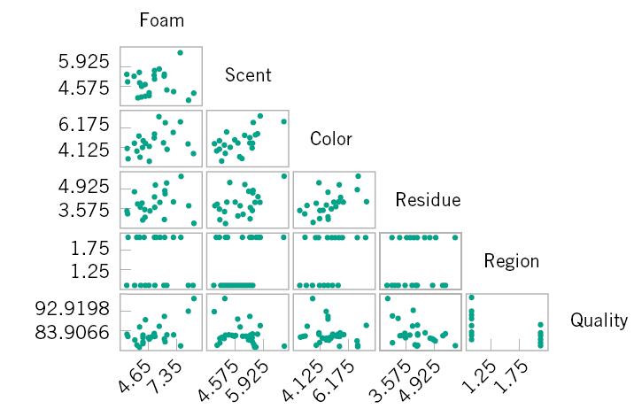
Matrix scatter plot

Slide 29
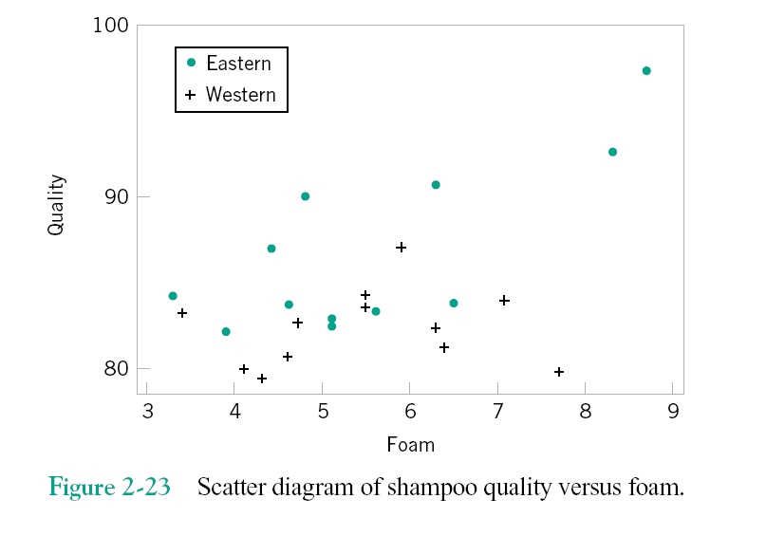
Plotting more than two variables

Slide 30
Prob-2.8
In a study, a drug is applied to a group of individuals and
the effect of the drug on synthesis of a particular protein is
monitored. Because there are natural variability on the
amount of protein synthesized, another group of individuals
(called “control group”) were studied under identical
environment and diet. The concentration of the protein in
blood for both the groups are as follows:
Under Medication (M): 16.1, 134.9, 52.7, 14.4, 124.3, 99.0,
24.3, 16.3, 15.2, 47.7, 12.9, 72.7
Control group (C): 297.1, 491.8, 1332.9, 1172.0, 1482.7,
335.4, 528.9, 24.1, 545.2, 92.9, 337.1, 102.3
Present and analyze the data.

Slide 31
Solution
We start by computing the mean and standard deviation
for both the groups:

Slide 32
Solution: Dot diagram

Slide 33
